Slide 1

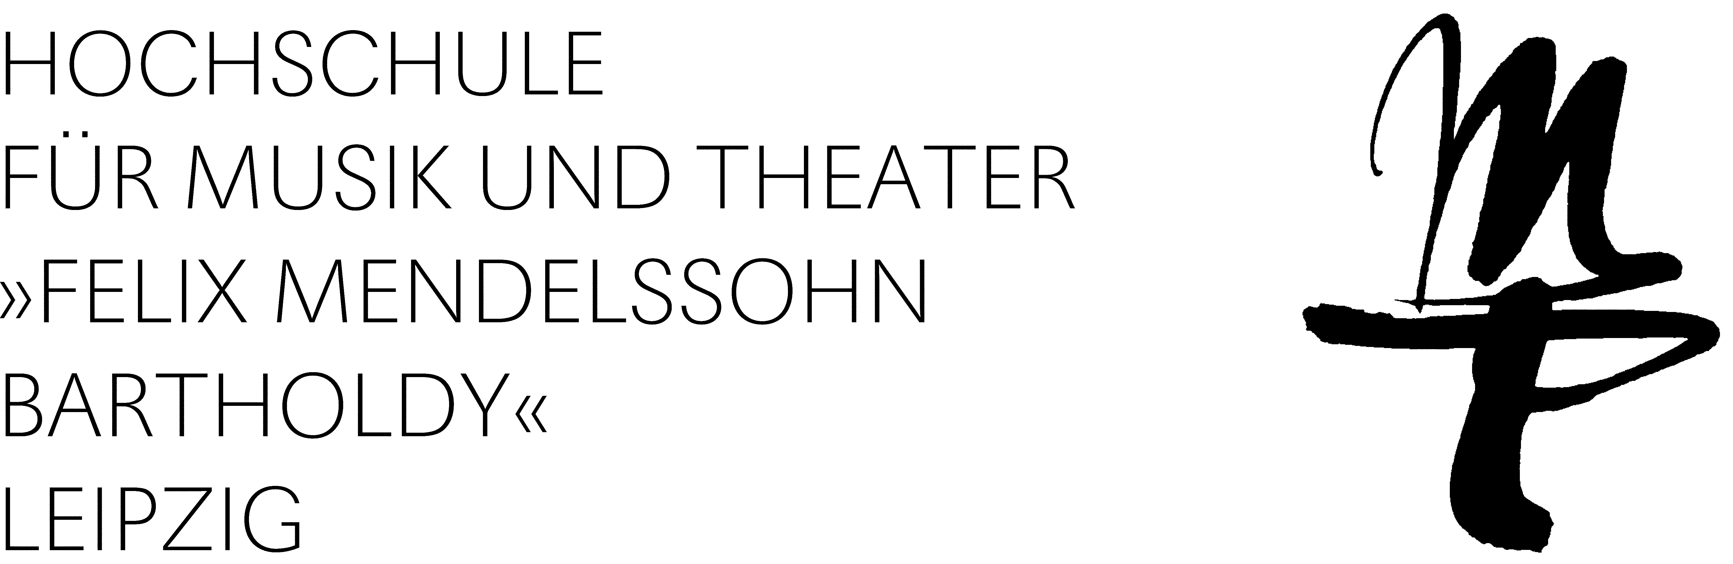
“Exploration of Timbre by Analysis and Synthesis” Using Python, Ableton and ChatGPT
Dr. Egor Polyakov

Slide 2
Historical and theoretical background
What is "Exploration of Timbre by Analysis and Synthesis"?
A theoretical concept developed by Jean Claude Risset in the 1960s.
Originated from his work at Bell Labs with Max Matthews.
Main Concept
Utilizes human sonic perception to evaluate the timbral quality of resynthesis.
Achieves a deeper understanding by comparing:
Original sound.
Its analytic model.
The synthesized version according to the model.
Helps to define the limits of what can be analyzed, modeled, and synthesized.
Reveals intricate details of the original sound through this comparative approach.

Slide 3

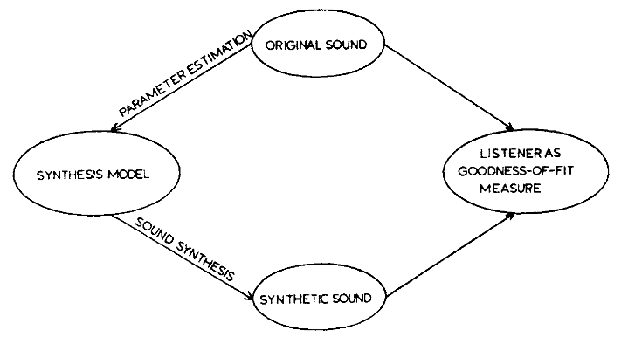
Conceptual framework of the analysis-synthesis process by Risset & Wessel (1999).

Slide 4

Conceptual Differences from Modern Workflows
No Real-Time Analysis or Synthesis
Unlike modern workflows, the original concept did not support real-time processing.
Spectral Analysis
Conducted via time-variant harmonic analysis.
The FFT algorithm by Cooley and Tukey, published in 1965, was not implemented until much later.
Software Utilized
(Additive) Synthesis was performed using the Music IV software run on the Bell Labs IBM 7094.
A deep understanding of the entire analysis/synthesis process was necessary for optimal workflow.
Rissset – Mutations (1969)

Slide 5
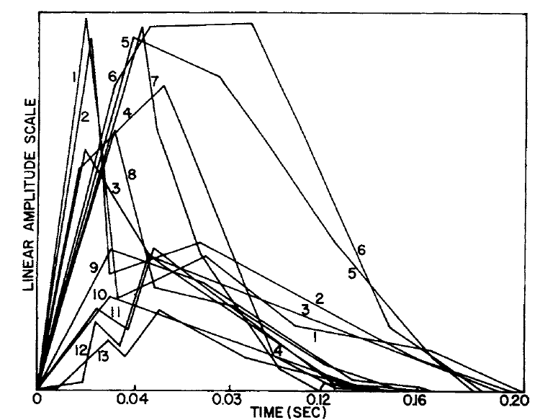
Example of Line-segment functions that approximate the evolution in time of 13 harmonics of a D4 trumpet tone lasting 0.2 sec (Risset & Matthews 1969).

Slide 6
“Exploration of Timbre by Analysis and Synthesis” today?
Feature extraction, symbolic representations
FFT-Analysis,
Additive Synthesis
Audiosculpt, OM, Csound

Slide 7
“Exploration of Timbre” within Modern Workflows
Real-Time Analysis or Synthesis
Real-time analysis and resynthesis are now possible, e.g., within Max.
Spectral Analysis
Various analyses based on FFT, such as partial tracking and chord sequence analysis.
Import/Export of spectral analysis values via SDIF.
Symbolic Representation
Open Music can be used for symbolic music representations of spectra.
Synthesis
Sophisticated synthesis methods are available within Csound.
Various feature representations can enhance understanding of the entire analysis/synthesis process as well as the initial properties of the analyzed sound.

Slide 8
“Exploration of Timbre” without Audiosculpt?
Introduction of 64-bit OSX 10.15 in 2019
Audiosculpt can no longer run on newer machines.
Licensing issues arise even on old 32-bit OSX machines.
Alternatives?
Spear
Buggy, SDIF not supported, not updated since 2019.
Partiels
Successor of Audiosculpt by IRCAM, initially released in 2021 with limited functionality.
Still actively in development, Available for free with Linux support.
Why not go Python and recreate the “original” Audiosculpt/OM setup?

Slide 9
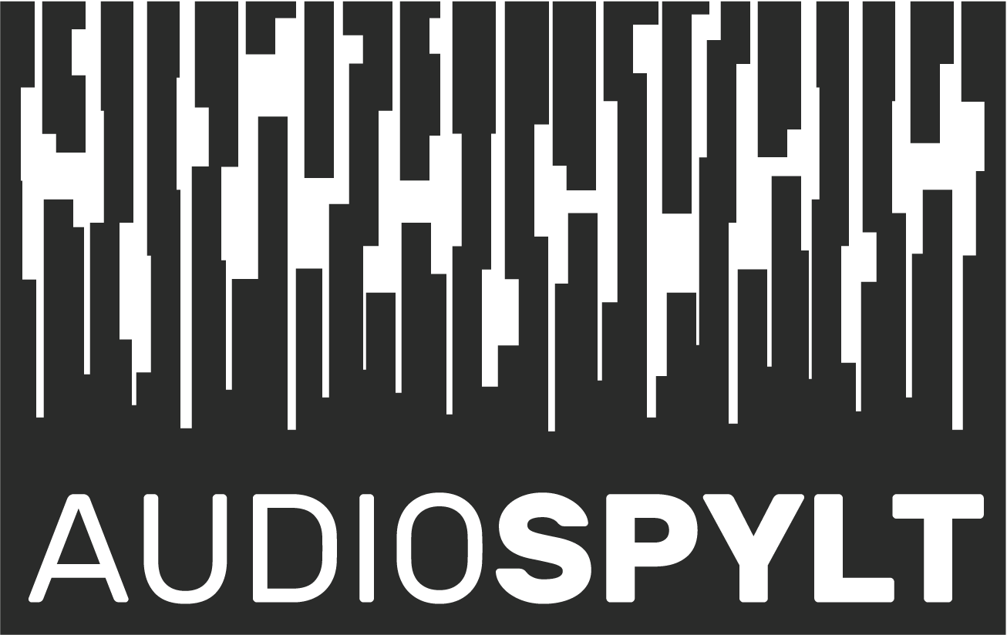
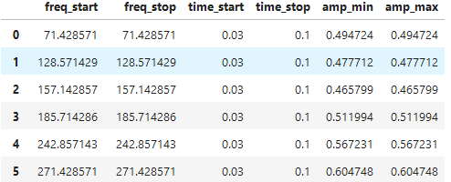
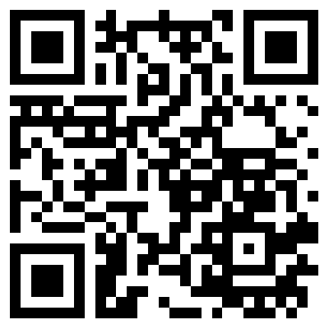
Introducing Audiospylt
Python-based toolbox tailored for sound analysis, re/synthesis, and diverse visual & symbolic sound representations.
Operates within the Jupyter Notebooks environment.
Audio in Python
Generating audio is equivalent to plotting a waveform.
Sample rate/bit depth functions as the resolution of your canvas.
Utilizes Pandas DataFrames for saving spectral information (frequency/amplitude tables).
SDIF support is coming!

Slide 10
“Exploration of Timbre” without Audiosculpt?
Introduction of 64-bit OSX 10.15 in 2019
Audiosculpt can no longer run on newer machines.
Licensing issues arise even on old 32-bit OSX machines.
Alternatives?
Spear
Buggy, SDIF not supported, not updated since 2019.
Partiels
Successor of Audiosculpt by IRCAM, initially released in 2021 with limited functionality.
Still actively in development, Available for free with Linux support.
Why not go Python and recreate the “original” Audiosculpt/OM setup?

Slide 11
DFT-Analysis,
Additive Synthesis
Can I replicate the sound outside of python with limited amount of Oscillators?

Slide 12
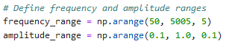
Synthesizing Sound Outside of the Python Environment
Comparison of Synthesis Methods
Additive synthesis in Audiospylt uses an almost unlimited number of operators.
For practical purposes, we need to restrict our output to a certain setting.
=> Additive Synthesis/FM Synthesis with limited number of operators (4).
Finding Optimal Settings for the Operators
Manual search (16 vCPU, CUDA/Torch only marginally faster):
Algorithmic search
=> Global Optimization Algorithms.
Objective Function
=> A mathematical function that quantifies the difference between the current candidate solution and the target solution.

Slide 13
ML Modell for Matching Spectra
Objective Function
(Metric for Comparison of Two Spectras)
Reference Set of Freq/Amp Values
Optimization Algorithm
Optimized Set of Freq/Amp Values
Objective Functions: Itakura-Saito distance, Cosine Similarity, Spectral Convergence distance, Euclidean distance, Manhattan Distance, Kullback-Leibler divergence, Pearson correlation coefficient, MFCC distance
Optimization Algorithms: Basin-hopping, Differential evolution, Dual Annealing

Slide 14
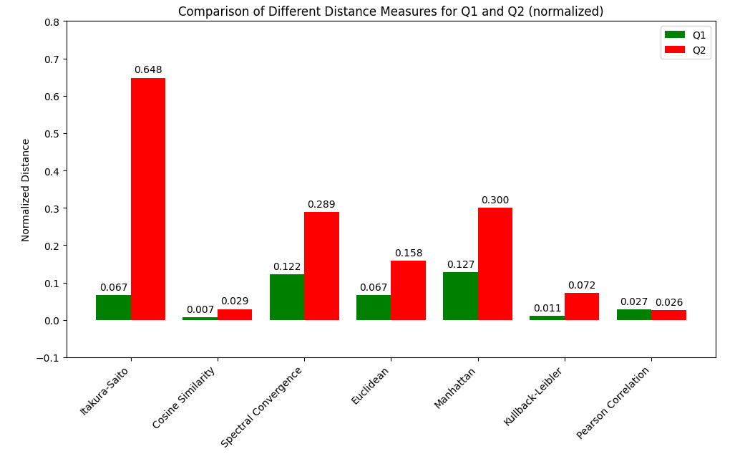
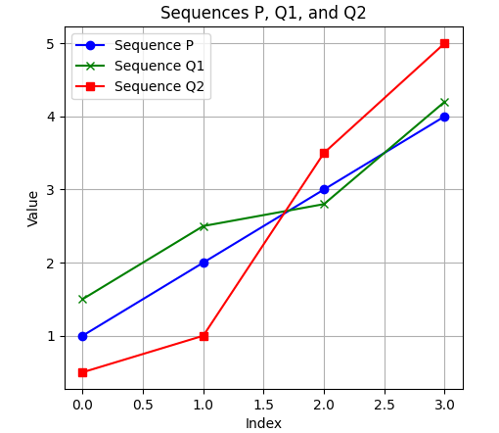
Objective Functions

Slide 15
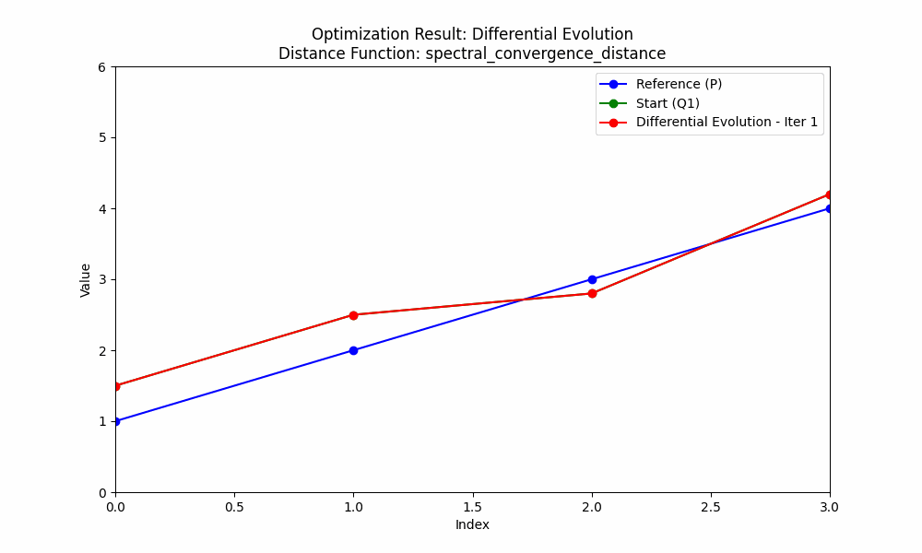
Optimization Algorithm Learning

Slide 16
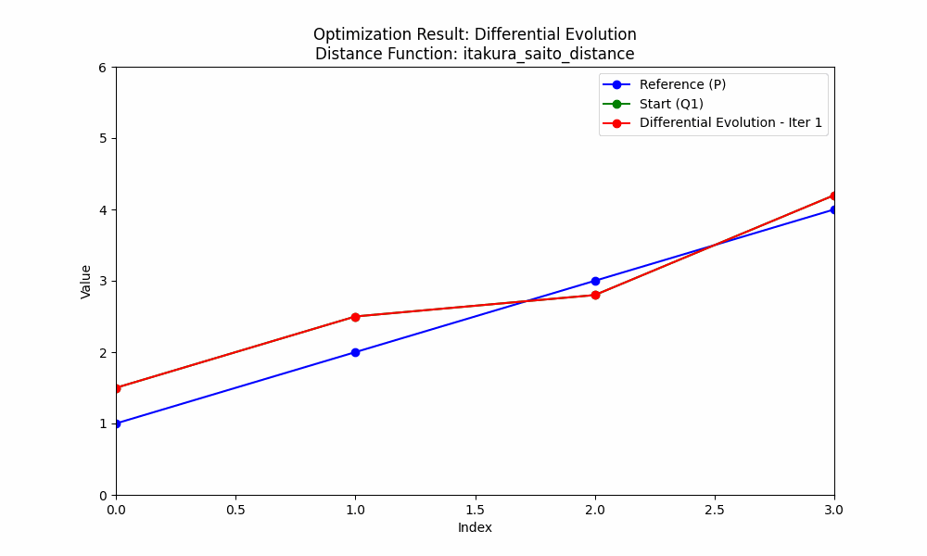

Slide 17
Final Setup and Evaluation
AM Synthesis: Implemented as OP1 + OP2 + OP3 + OP4.
FM Synthesis: Implemented as OP4 => OP3 => OP2 => OP1.
Optimization is VERY SLOW (up to 30 min on 16 vCPU).
Performance depends on the selected objective function and optimization algorithms.
General evaluation of the best-fitting objective function and optimization algorithms is difficult.
Performance varies due to randomness and variance in reference spectra.
Optimization Algorithms and Objective Functions
Differential Evolution: Most stable and best-performing optimization algorithm
Itakura-Saito and Kullback-Leibler Divergence most stable and best-performing objective functions for AM.
Cosine Similarity and MFCC Distance best performing for FM.
Basin-Hopping: Poor performance but retained for artistic purposes

Slide 18
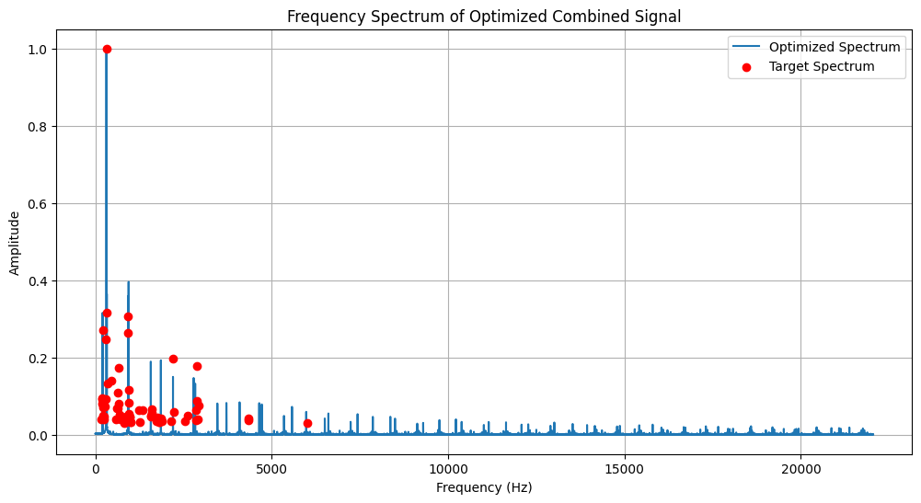
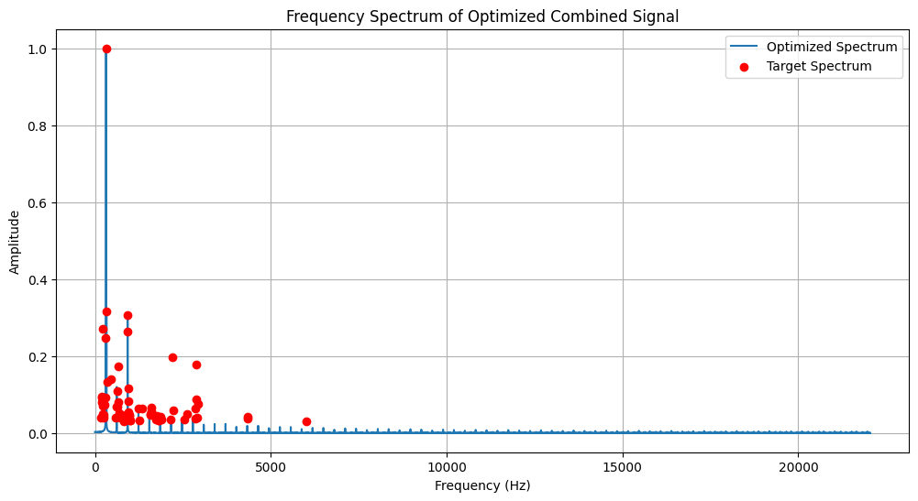
Itakura-Saito Distance with Differential Evolution (AM)
Cosine Similarity with Differential Evolution (AM)

Slide 19
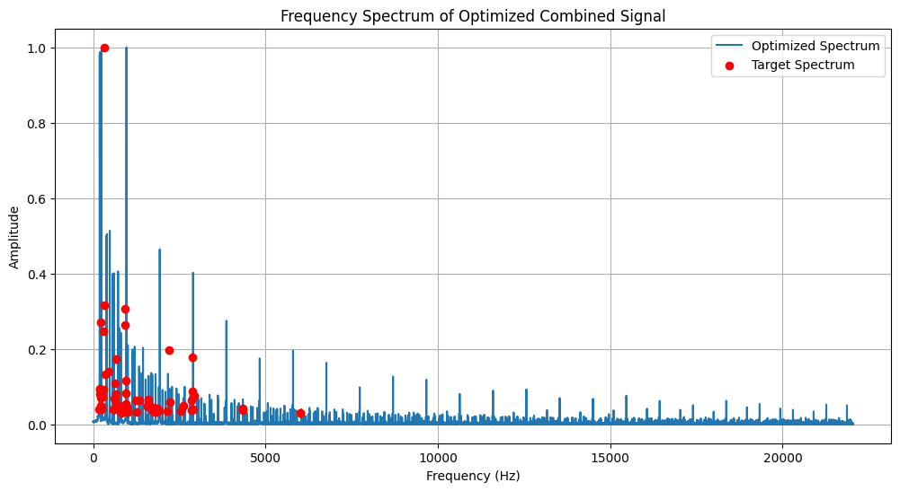

Spectral Convergence Distance with Differential Evolution (AM)
Euclidean Distance with Differential Evolution (AM)

Slide 20
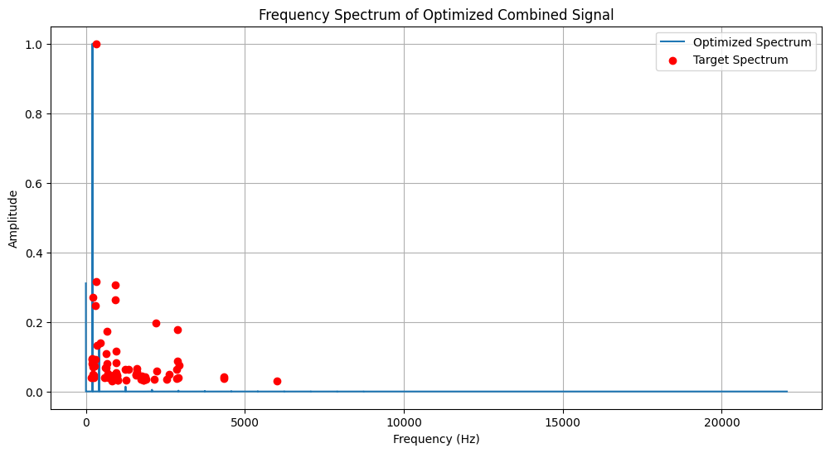
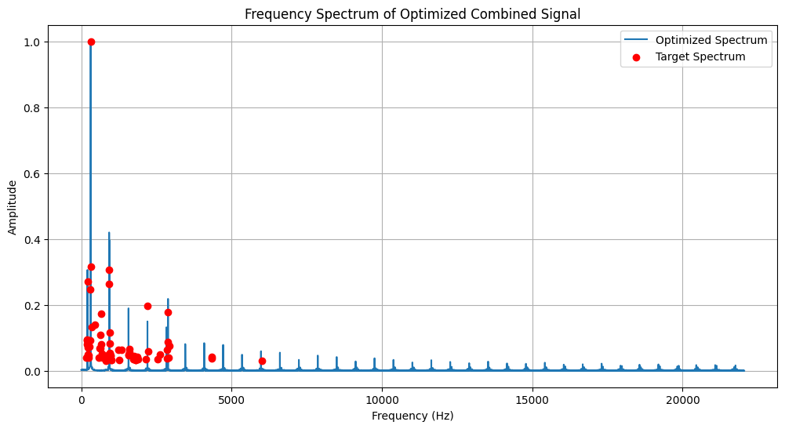
Manhattan Distance with Differential Evolution (AM)
Kullback-Leibler Divergence with Differential Evolution (AM)

Slide 21
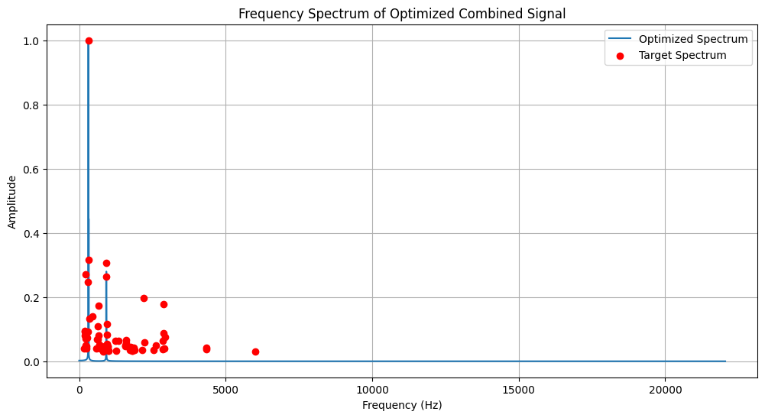
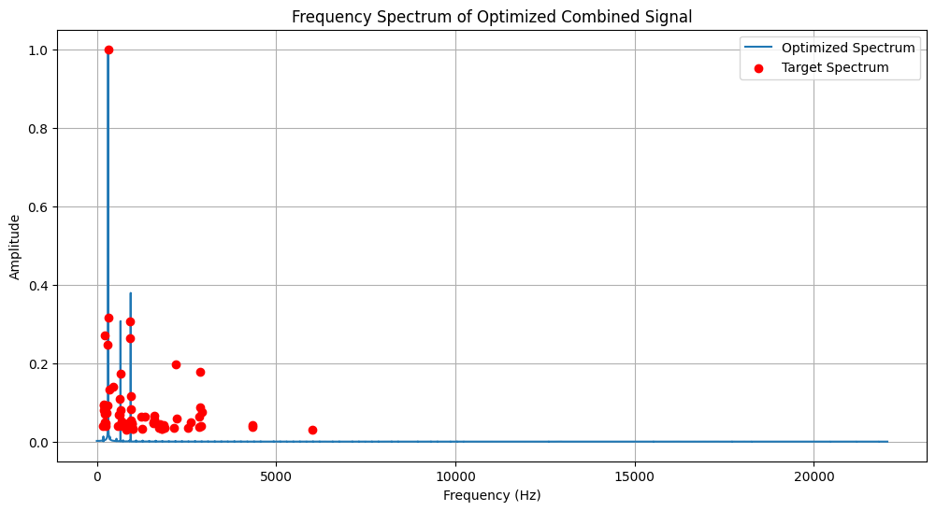
Pearson Correlation Coefficient with Differential Evolution (AM)
MFCC Distance with Differential Evolution (AM)

Slide 22
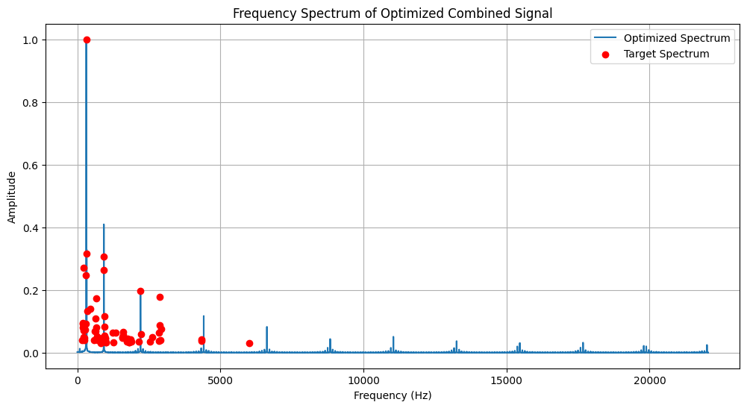
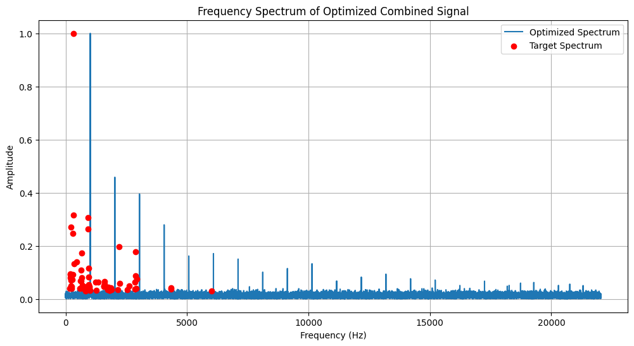
Itakura-Saito Distance with Dual Annealing (AM)
Itakura-Saito Distance with Basin-hopping (AM)

Slide 23
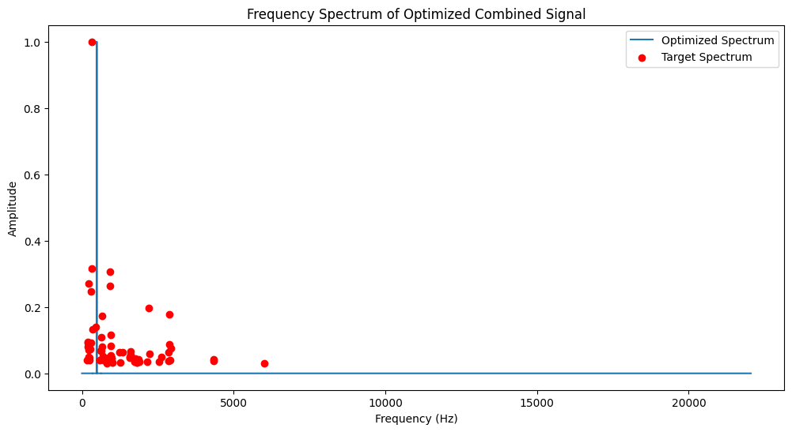
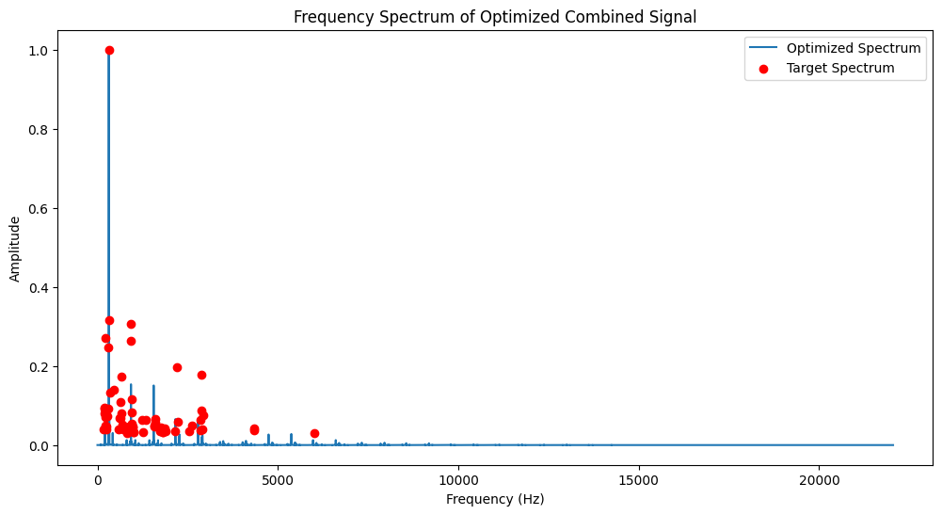
Itakura-Saito Distance with Differential Evolution (FM)
Cosine Similarity with Differential Evolution (FM)

Slide 24
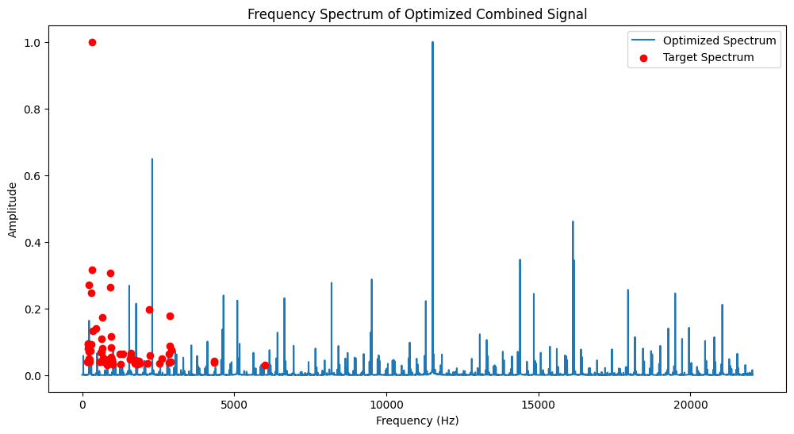
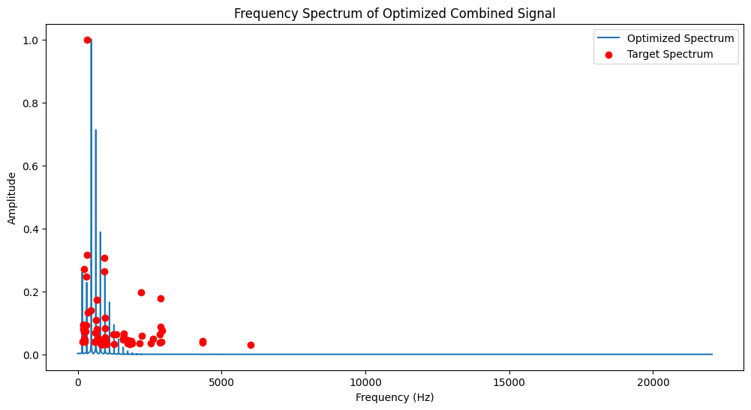
Spectral Convergence Distance with Differential Evolution (FM)
Euclidean Distance with Differential Evolution (FM)

Slide 25
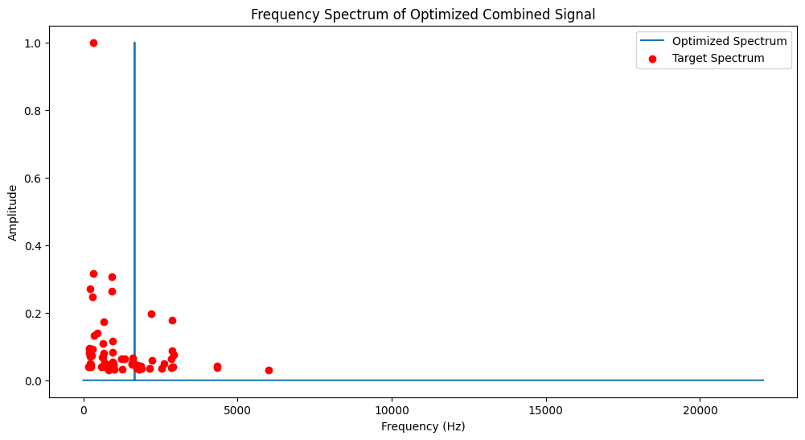
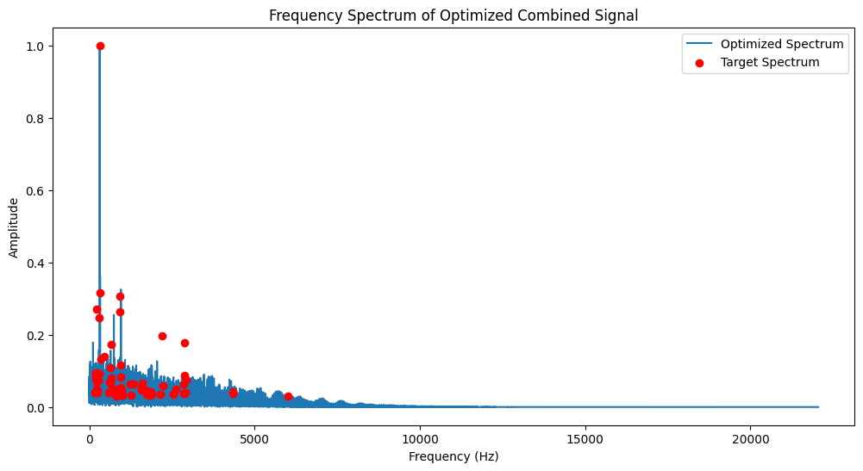
Manhattan Distance with Differential Evolution (FM)
Kullback-Leibler Divergence with Differential Evolution (FM)

Slide 26
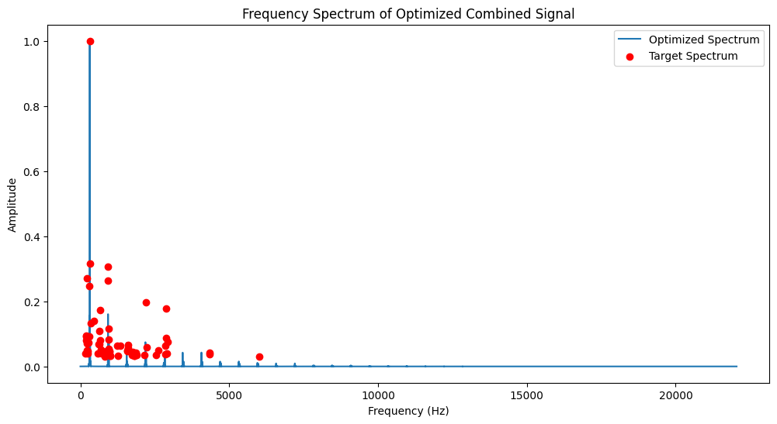
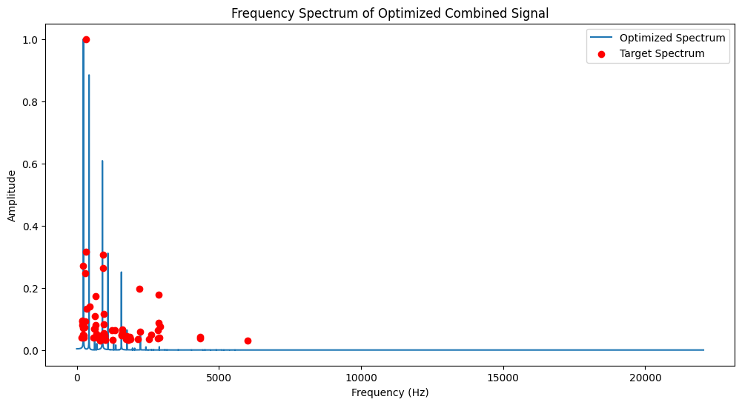
Pearson Correlation Coefficient with Differential Evolution (FM)
MFCC Distance with Differential Evolution (FM)

Slide 27
Recorded Cello Sample
4 Operator FM Resynthesis (Cosine Similarity)
Original Audio
4 Operator FM Resynthesis (Kullback-Leibler)
Cut (DFT Frame)
Origianal Audiospylt Resynthesis
4 Operator AM Resynthesis (Itakura-Saito)

Slide 28
How to Implement the Calculated Values into DAW/Plugins
Implementation in Ableton
Ableton's Operator synth consists of 4 operators.
Replicating Sound in "Fixed" Mode => Use the frequency/amplitude table directly.
Using MIDI as Input => Remap the frequency/amplitude table using "Coarse" and "Fine" settings => another optimization problem ☺.
No dedicated approach needed due to the simple search method.
Low resolution of "Fine" settings introduces quantization in the frequency table.
Works well for AM synthesis, but (was) problematic for FM because of undocumented Index scaling => thankfully somebody on reddit made a comparison between Dexed Arturia DX7V and Operator that lists exact index values as multiplier.
Creating a Preset from calculated values => ChatGPT is here to help!

Slide 29
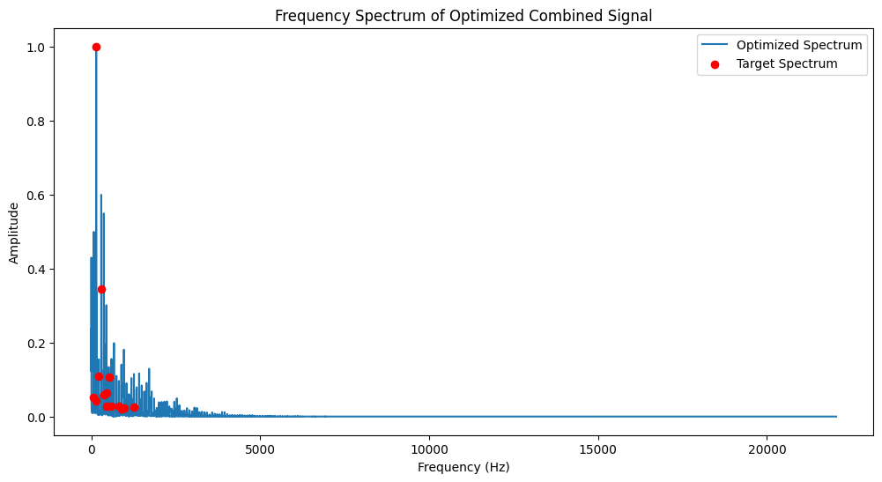
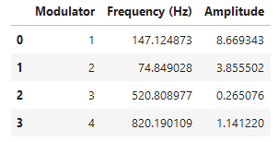
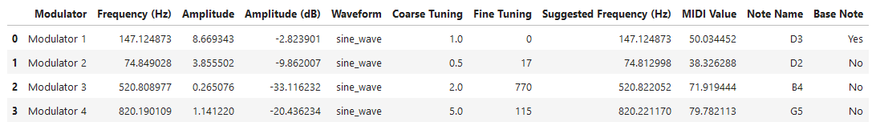

Slide 30
Analyzing Preset Files with ChatGPT-4
Able to handle complex files, such as Operator presets, which consist of approximately 3300 lines in a gzip compressed XML file.
Successfully identifies crucial tags for Operator manipulation such as Coarse, Fine, Volume, and Waveform settings.
Despite Ableton/Operator being closed-source with no available documentation, ChatGPT accurately locates necessary tags.
Some initial guesses may be incorrect, but reasoning with the model can guide it correctly.
Analyzing presets works flawlessly for well-documented open-source plugins like Dexed or Surge—likely because their openly available documentation was used in the training of the model.
Overall, the use of ChatGPT can significantly shorten the time for analysis of preset structure and adaptation of plugins.

Slide 31
Similar Products and Approaches
Commercial:
Sonic Charge Synplant 2 with Genopatch
Micro Music with Vital synthesizer
Open Source:
Spiegelib: https://github.com/spiegelib
preset-gen-vae: https://github.com/gwendal-lv/preset-gen-vae
DDX7: https://github.com/fcaspe/ddx7
IRCAM RAVE: https://github.com/fcaspe/RAVE
To Dos:
More waveforms, general wave-table support
Advanced FM implementation => Full Dexed support
Full Surge support
GUI and usability improvements (current implementation requires at least basic Python understanding)
Multi-frame FFT support
Integration of dx7pytorch for CUDA-based calculations (should be MUCH faster compared to current version)

Slide 32
THANK YOU!!!
egor.polyakov@hmt-leipzig.de
https://github.com/klirr2007

